Slide 1
Cracking Windows Passwords with Cain

Slide 2
Notes
Works in Windows 7, 8, and 10
Cain will be detected as malware by your virus scanner.

Slide 3
Download Cain
https://samsclass.info/123/proj10/ca_setup-4-9-56.7z
Password: sam

Slide 4
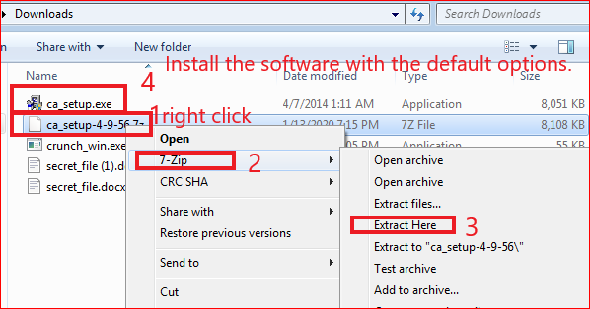
Installing Cain
If you don't have 7-Zip, get it here:
http://www.7-zip.org/

Slide 5
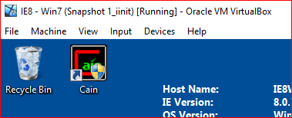
After installation

Slide 6
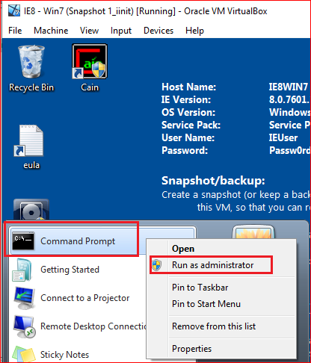
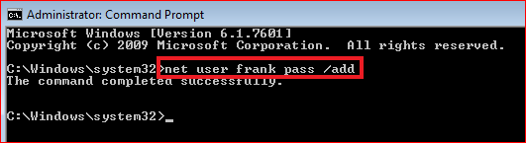
Creating Passwords

Slide 7
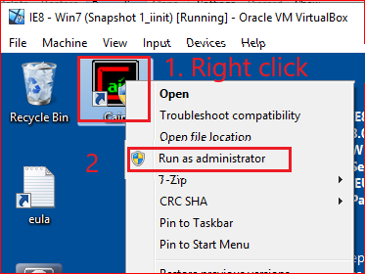
Show Password Hashes

Slide 8
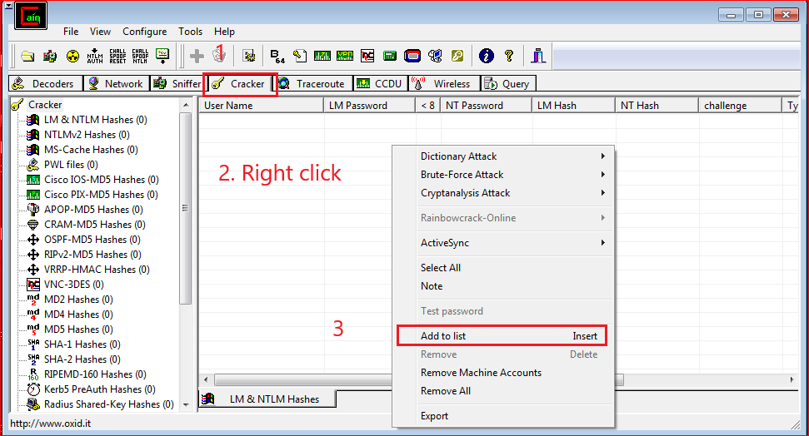

Slide 9
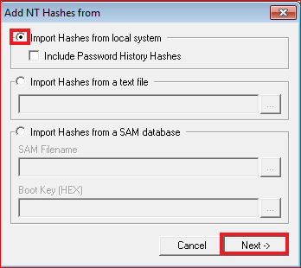
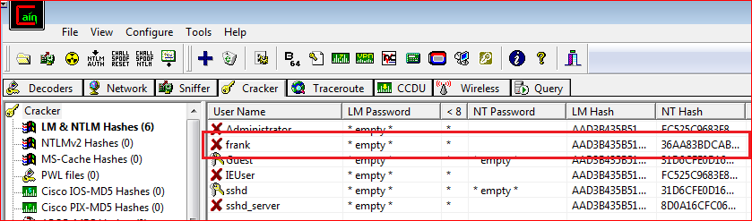

Slide 10
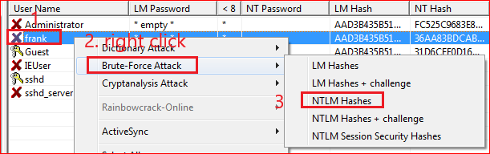
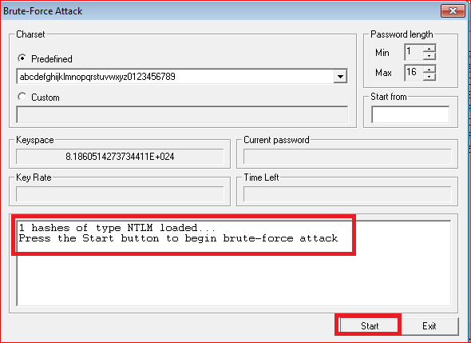
Cracking Passwords

Slide 11
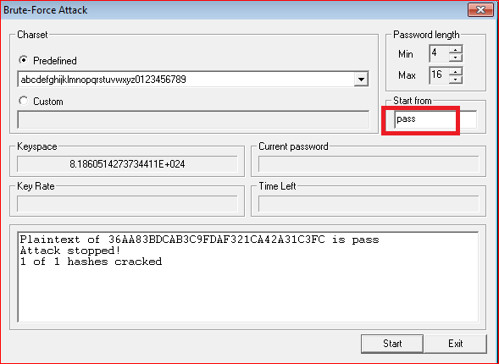
Results

